Slide 1

Effect of Whole Body Radiation Exposures on DNA Methylation in the Brain of the Irradiated Mouse
(Poster #1)
Janet Baulch, Ph.D.
Department of Radiation Oncology
University of California, Irvine
Applicability of Radiation Response Models to
Low Dose Protection Standards
October 2, 2018

Slide 2
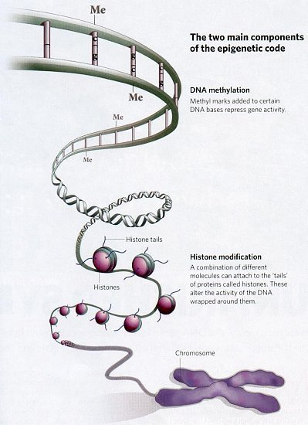
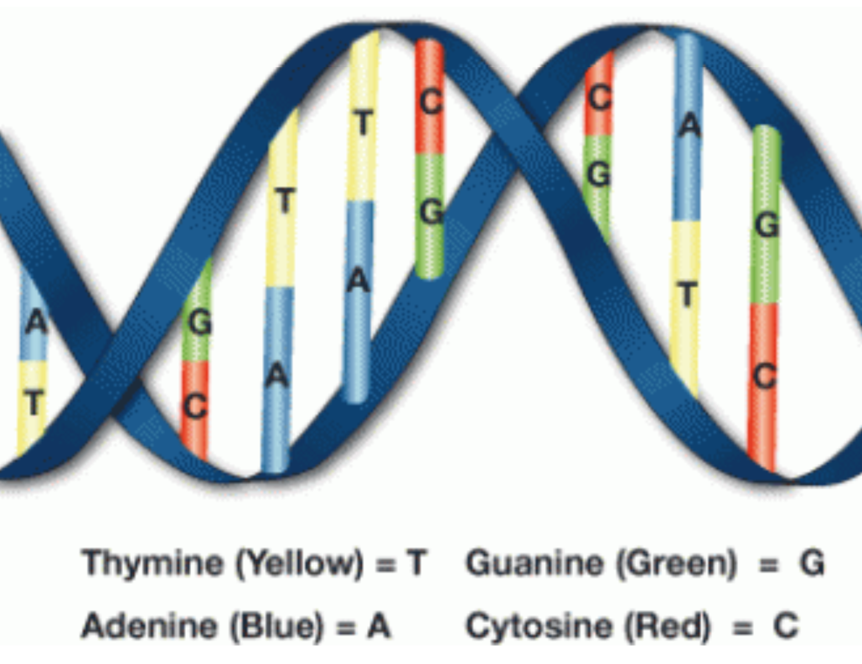
Background: What is Epigenetics?
Epigenetics – mechanisms to activate or silence genes without altering the primary base sequence of DNA.
Mechanisms:
DNA Methylation
Histone Modifications

Slide 3
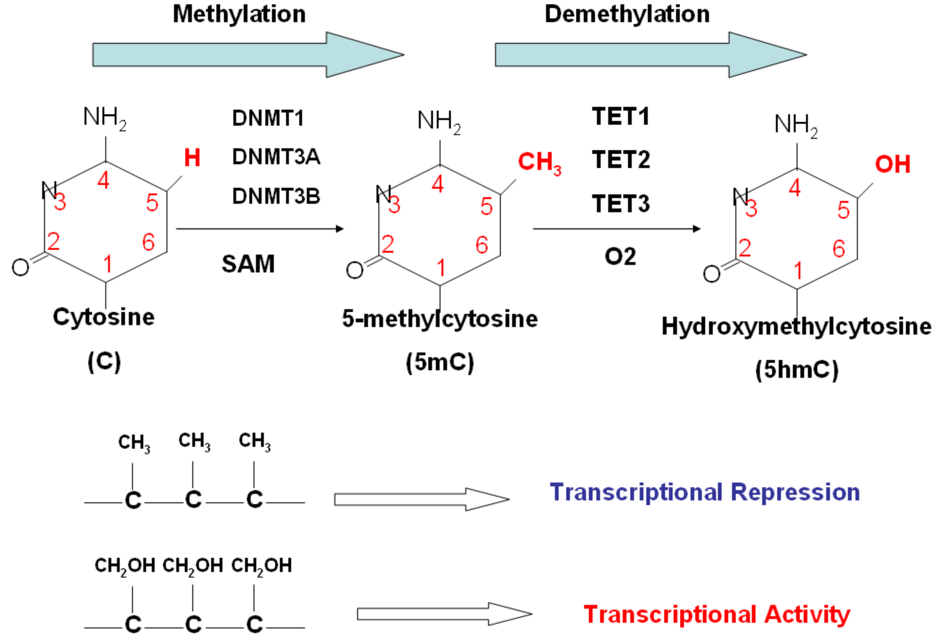
DNA Methylation and Methylating Enzymes
5mC
5hmC

Slide 4
Can we use mechanistic data in Risk Assessment?
DNA Methylation:
An excellent biomarker for radiation exposure, even at very low doses
Functional relationship to risk still largely lacking (what genes or regions of the genome to interrogate)
Is risk always the correct word, rather than adaptation or reprogramming?

Slide 5
Can we use mechanistic data in Risk Assessment?
More than just carcinogenic risk:
Carcinogenesis is not the only potential adverse outcome.
The CNS is sensitive to irradiation and cognitive dysfunction manifests in radiation oncology relevant and NASA relevant exposure paradigms, and is also of concern to the US DoD.
The effects of irradiation on brain function are late manifesting and persistent.

Slide 6
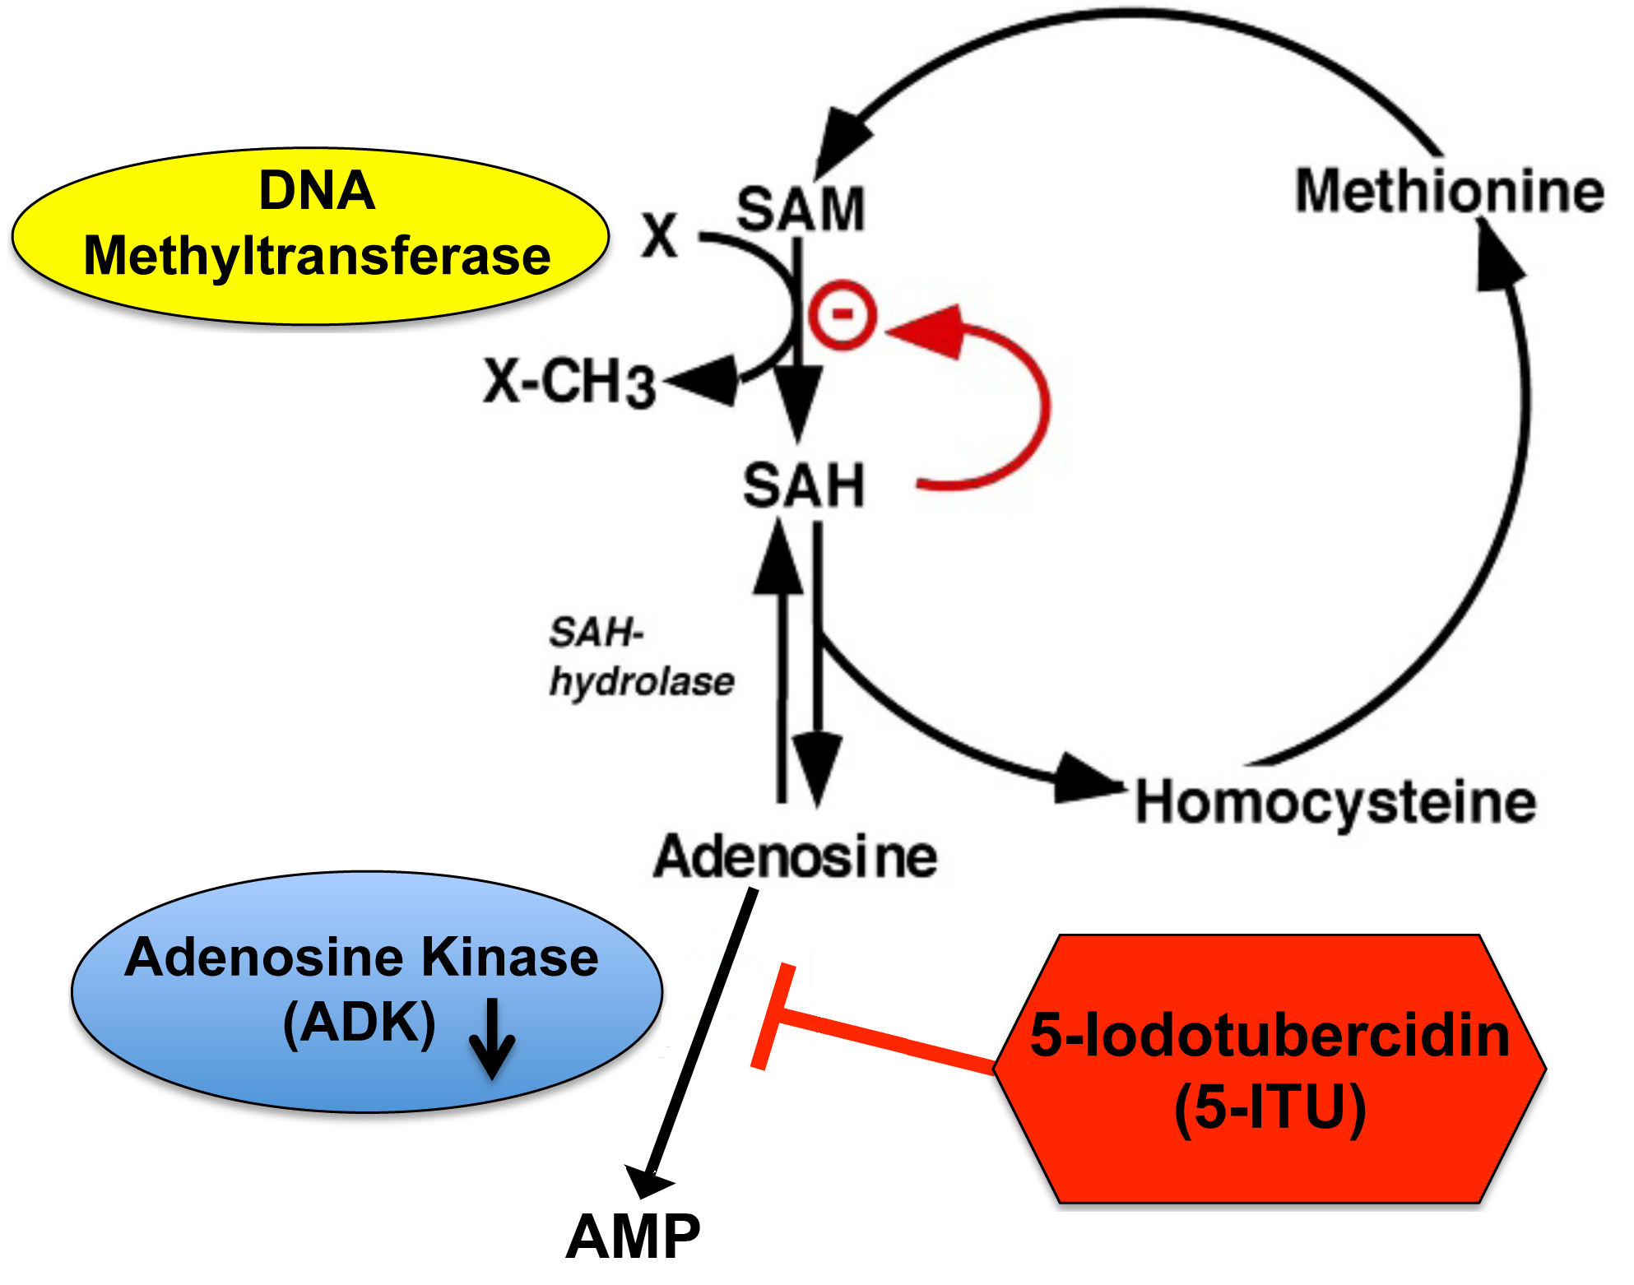
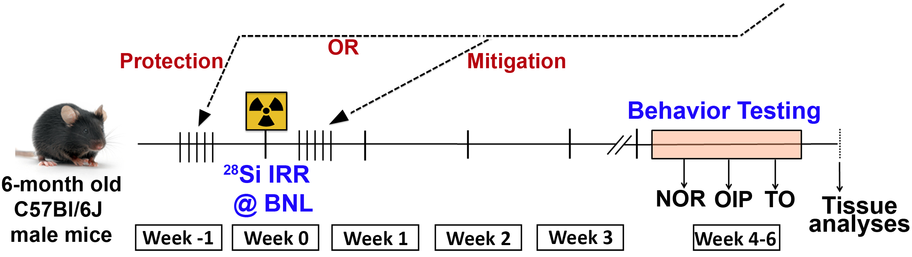
Role for DNA Methylation in Radiation Induced Cognitive Deficits Heavy Ion Study (20 cGy ²⁸Si 600MeV/n)
5-ITU indirectly blocks DNA methylation through inhibition of adenosine kinase activity
DNA Methylation
Acharya et al. Scientific Reports, 2017 Feb 21;7:42885. doi: 10.1038/srep42885

Slide 7
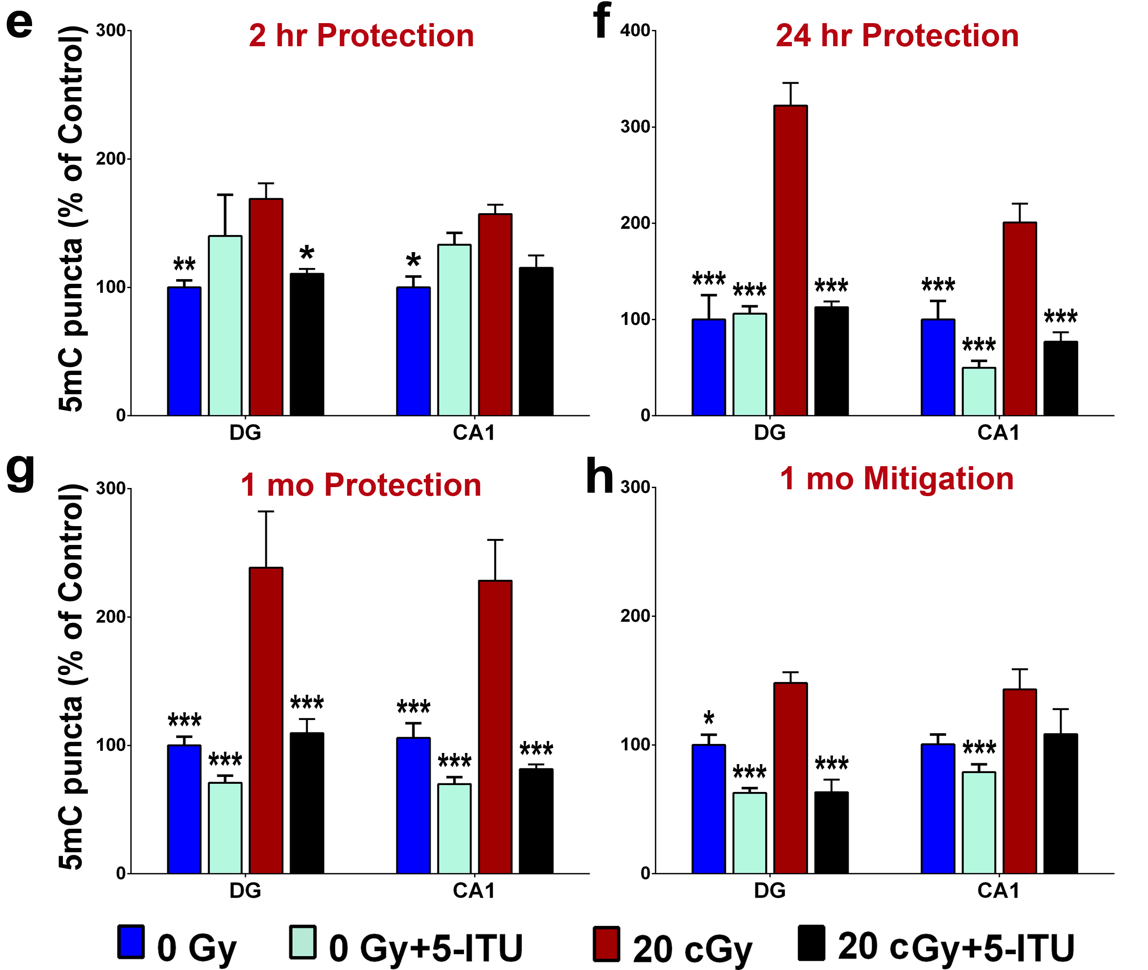
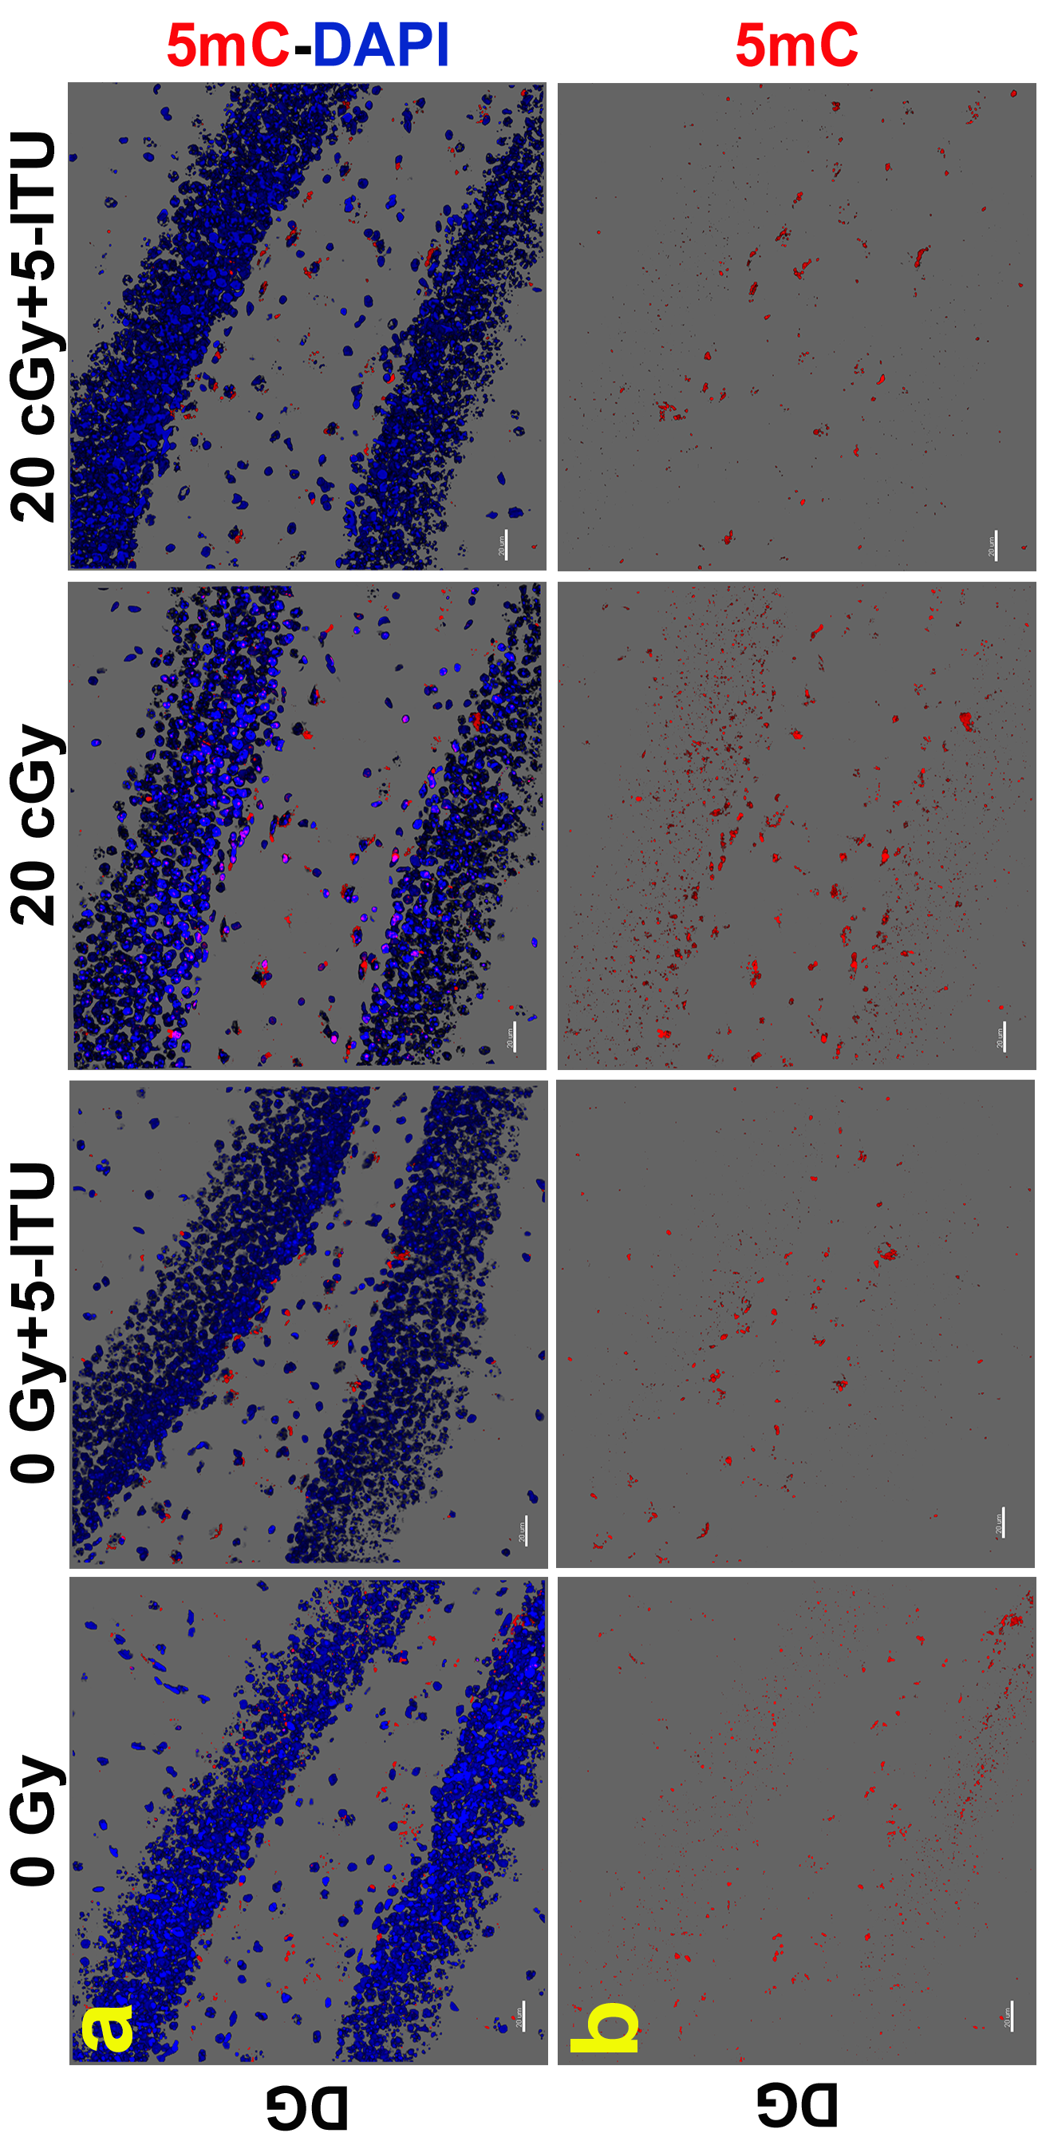
5mC in the Hippocampus of the Irradiated Mouse
(Whole Body, 20 cGy ²⁸Si Particles)
* P < 0.05, ** P < 0.01, *** P < 0.001 for 0Gy, 0Gy+5-ITU and 20cGy+5-ITU as compared to 20 cGy

Slide 8
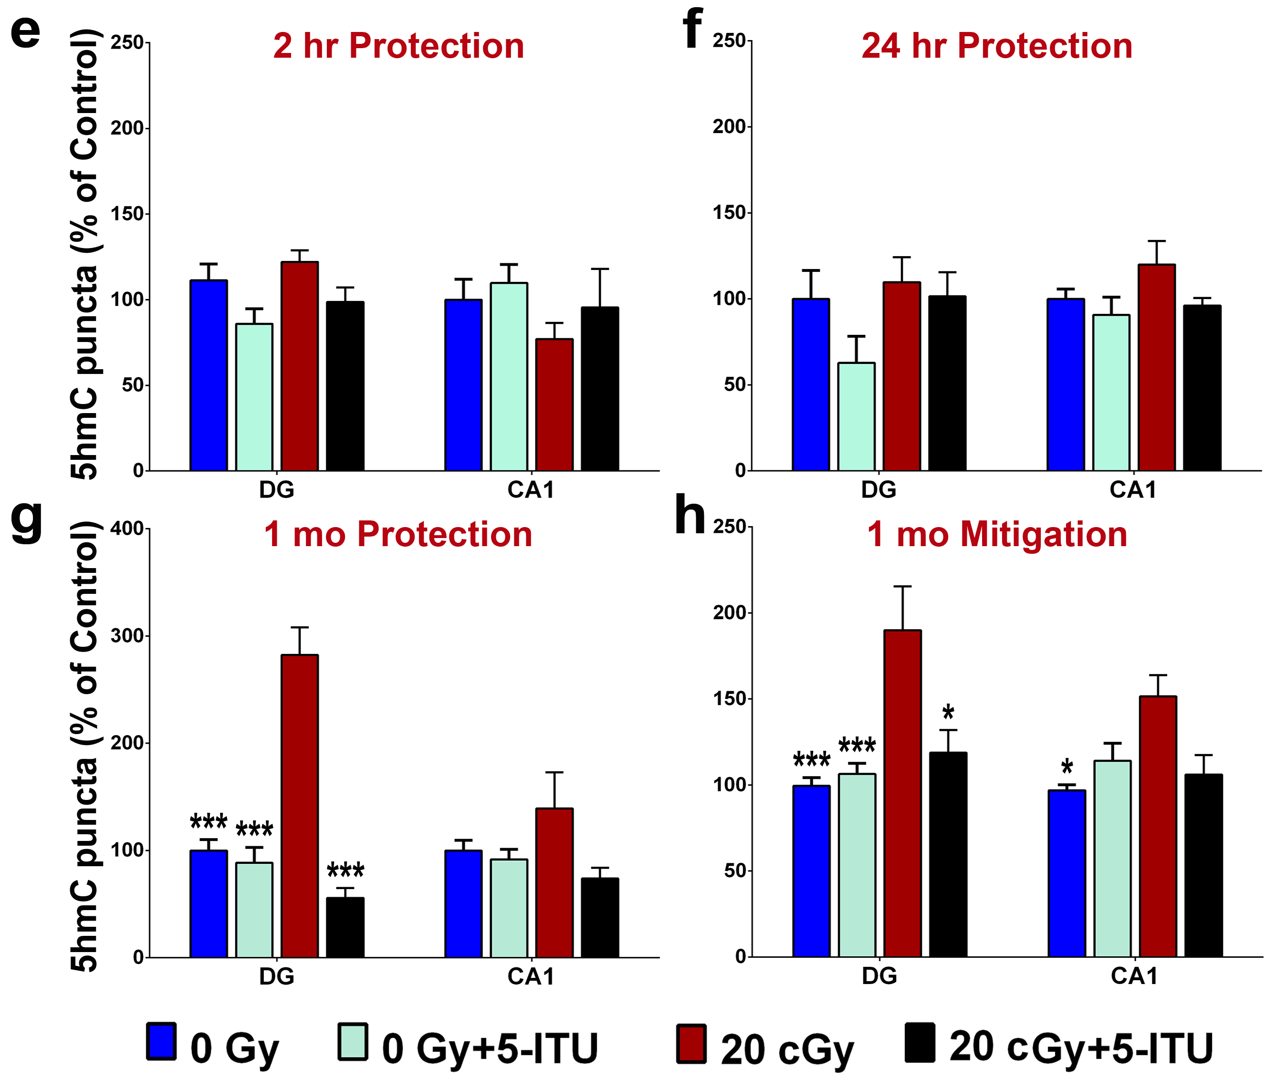
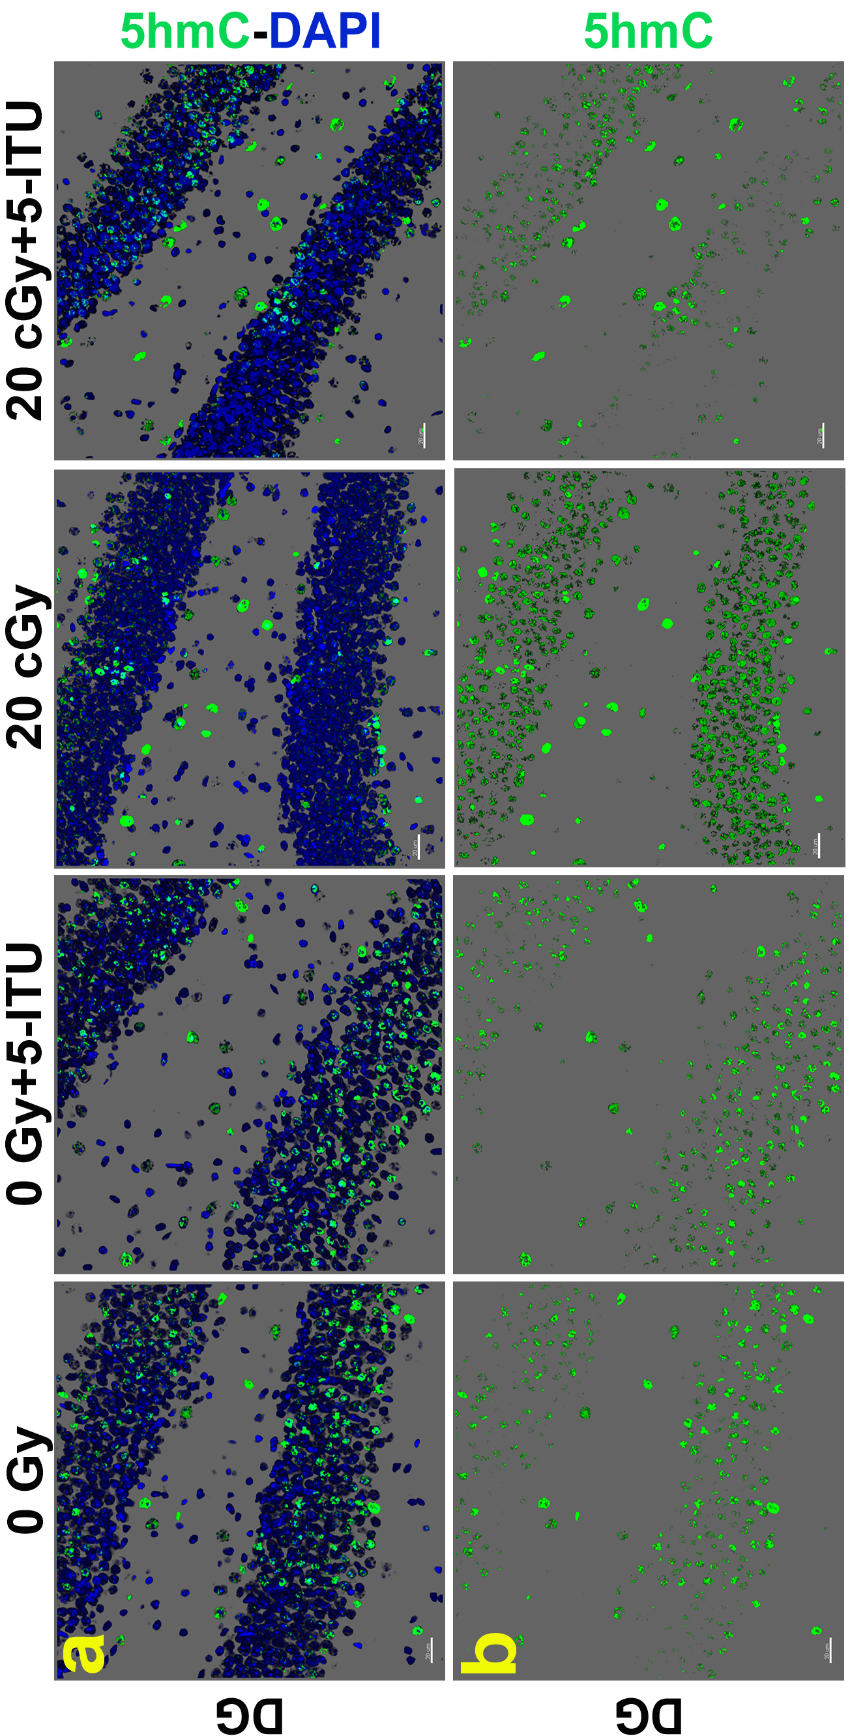
5hmC in the Hippocampus of the Irradiated Mouse
(Whole Body, 20 cGy ²⁸Si Particles)
* P < 0.05, ** P < 0.01, *** P < 0.001 for 0Gy, 0Gy+5-ITU and 20cGy+5-ITU as compared to 20 cGy

Slide 9
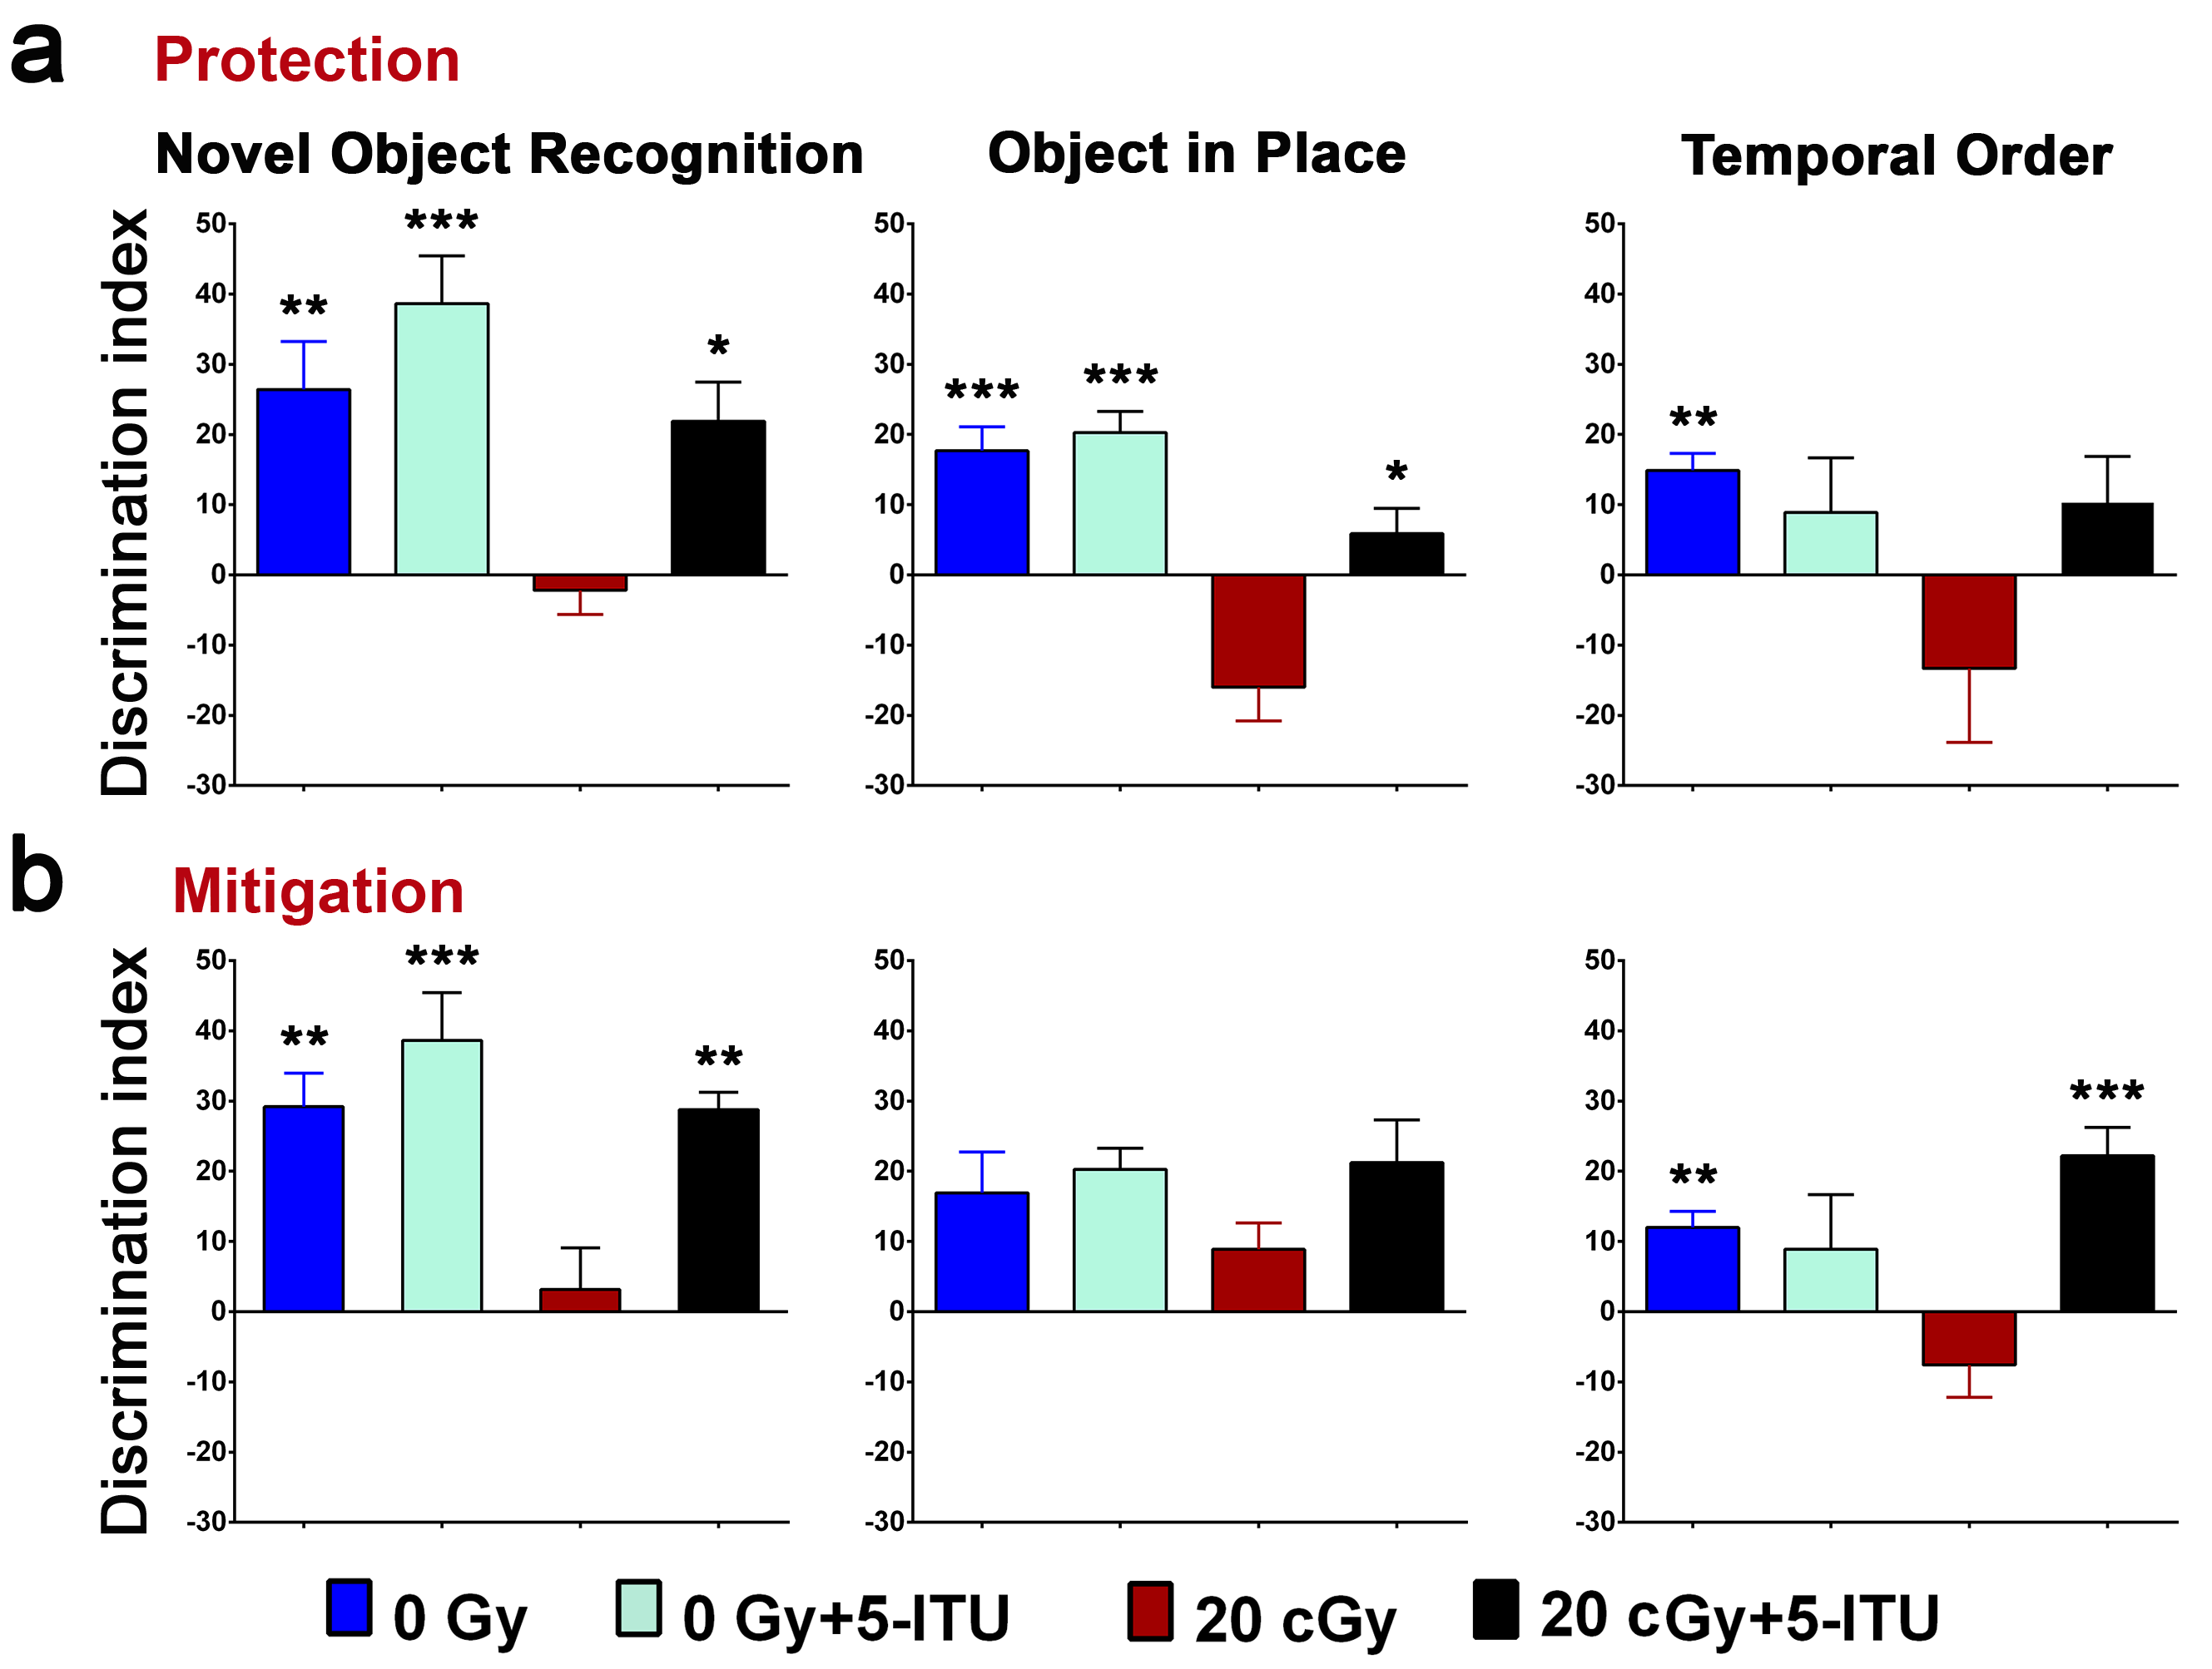
Cognitive Impairment of Irradiated Mice on Open Arena Tasks
(Whole Body, 20 cGy ²⁸Si Particles)
* P < 0.05, ** P < 0.01, *** P < 0.001 for 0Gy, 0Gy+5-ITU and 20cGy+5-ITU as compared to 20 cGy

Slide 10
Can we use mechanistic data in Risk Assessment?
DNA Methylation:
An excellent biomarker for radiation exposure, even at very low doses
Functional relationship to risk still largely lacking, but our and other CNS studies suggest at least correlation to adverse outcome
Arguably amenable to pharmacologic/ biologic protection or mitigation strategies

Slide 11
Can we use mechanistic data in Risk Assessment?
Large Well-Described Human Cohorts:
Mayak, Techa River, LSS, Fukushima
Longitudinal well designed epigenetic studies of these cohorts that could provide correlative or functional link between exposure and disease risk.
Exploration of cognitive endpoints (radiation effects manifest as neuropathologies similar to Alzheimer’s Disease)

Slide 12

Radiation Oncology, UC Irvine
Charles Limoli, PhD, Research Director
Senior members:
Munjal Acharya, PhD (Co-PI)
Vipan Parihar, PhD
Erich Giedzinski, Lab manager
Students:
Ron Leavitt (graduate)
Leila Alikhani (undergraduate)
Mineh Markarian (undergraduate)
Jabra Baddour (undergraduate)
Nicole Yoon
Takumi Kawashita
Thuan (Alex) Nguyen
Staff Researchers:
Lauren Apodaca
Al Anoud Baddour
Maria Angulo
Ning Ru
Liping Yu
Amber Syage

